Slide 1
Global Literacy Rate & Education Investment Analysis
By: Acquah Damilola

Slide 2
OVERVIEW
Introduction
Global Literacy Rate
Gender Gap On Literacy
Impact Of GDP On Literacy
Conclusion
Recommendation
Sources

Slide 3
Introduction
Literacy is a fundamental driver of economic growth, social development, and individual empowerment. This analysis explores global literacy rates and education investment trends, identifying key factors that influence literacy improvement. By examining country-level data, we uncover insights into gender disparities, economic impact, and government spending on education. The goal is to highlight actionable strategies for enhancing literacy worldwide.

Slide 4
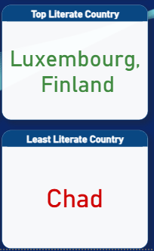
Global Literacy Rate
From analysis, global literacy rate is about 81%. Having Finland and Luxemburg as highest literate countries both 100%, while Chad is the least literate country with 21%.

Slide 5
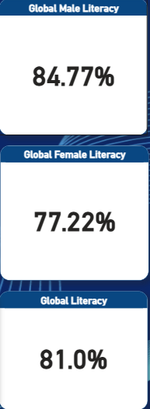
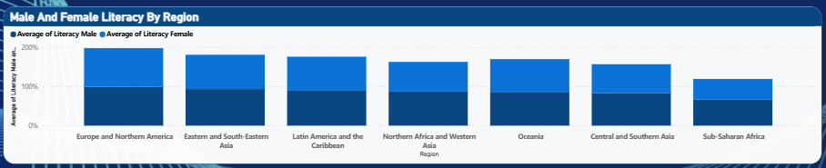
Gender Gap On Literacy
With exception of the Top Literate Countries, we have more male literate than female in most of the countries.
In the Europe and Northern America Region, we averagely have equal numbers in male to female literacy

Slide 6
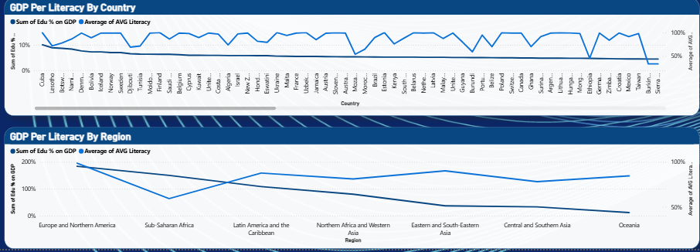
Impact Of GDP On Literacy
Many countries with high GDP tend to have high literacy rates. However, this is not always the case, as factors such as insecurity, religion, and insurgencies can disrupt this trend. Additionally, while some countries with high education funding show positive results, others fail to meet expectations due to mismanagement and inefficiencies.

Slide 7
Conclusion
Global literacy rates are influenced by economic investment, governance, and socio-political factors. While countries with higher GDP often achieve better literacy outcomes, challenges such as insecurity, inequality, and mismanagement can hinder progress. Effective education funding, policy reforms, and inclusive learning strategies are key to improving literacy rates worldwide. Addressing these factors can create a more educated, skilled, and empowered global population.

Slide 8
Recommendation
Increase Education Funding Efficiently – Governments should allocate at least 4–6% of GDP to education and ensure proper utilization to maximize impact.
Improve Access to Quality Education – Invest in teacher training, school infrastructure, and learning resources, especially in underserved areas.
Address Socio-Cultural Barriers – Promote gender-inclusive policies and tackle religious and cultural restrictions that limit education access.
Leverage Technology for Learning – Expand digital education initiatives to bridge gaps in literacy, especially in remote areas.
Strengthen Governance & Transparency – Implement accountability measures to reduce mismanagement of education funds and improve policy execution.
Promote Literacy Awareness Programs – Encourage community-driven education campaigns to increase enrollment and retention rates.

